Slide 1
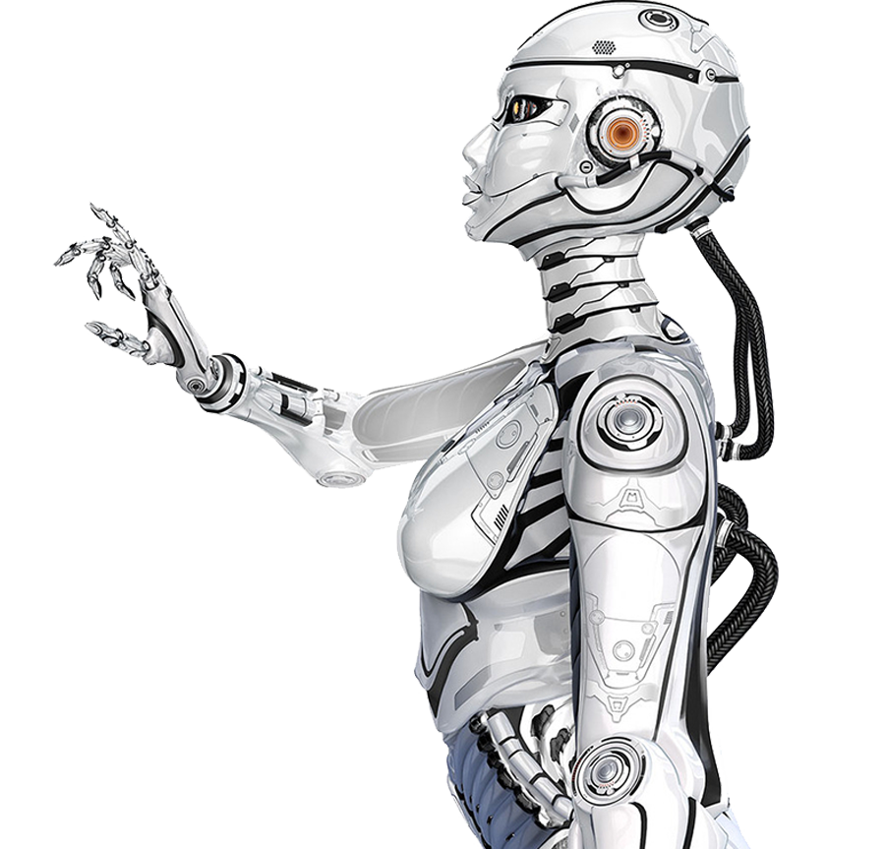
Leading the Future
The Power of GPT
Artificial intelligence
Team Member Responsibilities：
温家振：PPT making
周同阳：Speech writing
章鹏程：Presenter
王昱硕：Video clip

Slide 2
01.
What is GPT
04.
GPT’s value
CONTENTS
02.
Applications of GPT
05.
Weaknesses of GPT
03.
Impact of GPT on Life
06.
The future of GPT

Slide 3
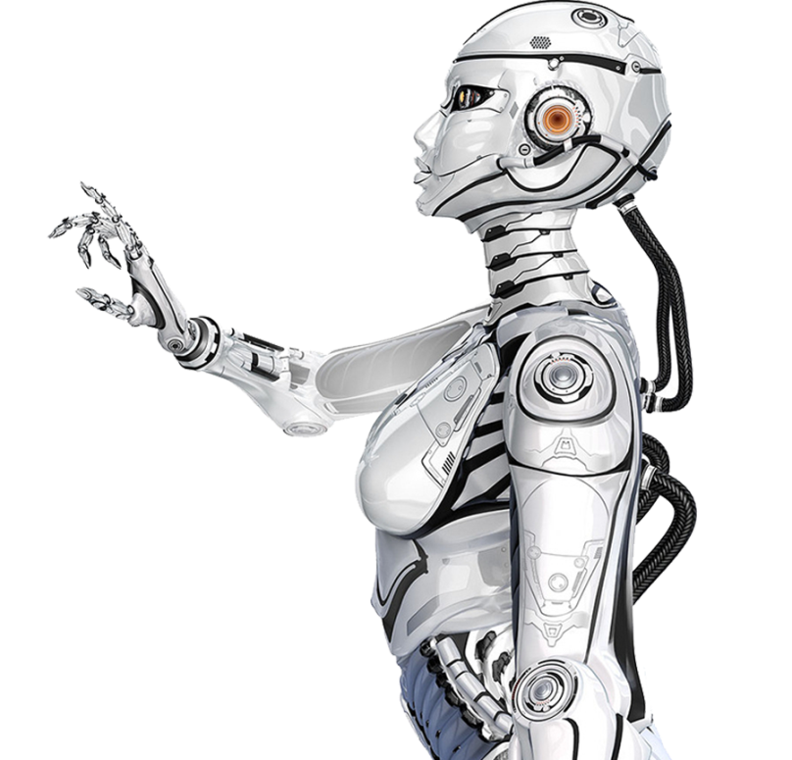
01.
What is GPT

Slide 4
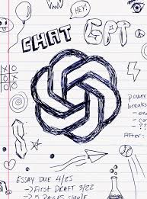
GPT
01
What is GPT
GPT, or Generative Pre-trained Transformer, is an AI model by OpenAI that generates human-like text using deep learning. It uses an "attention" mechanism for better understanding and response generation.
GPT learns from diverse internet text (pre-training) and is fine-tuned for specific tasks, enhancing its performance.
GPT is used in various applications, from drafting emails to writing code, showcasing its versatility in AI and natural language processing.

Slide 5
01
What is GPT
GPT
T
G
The "G" in GPT stands for "Generative". This refers to the model's ability to generate new content. Unlike some AI models that can only classify or label existing data, GPT can create new text based on the input it receives. It does this by predicting the likelihood of each word given the previous words in the input sequence.
The "T" in GPT is "Transformer". A transformer is a type of model architecture used in machine learning. It's known for its use of an "attention" mechanism, which allows the model to focus on different parts of the input when producing an output.

Slide 6
02.
Applications of GPT

Slide 7
Language Translation
02
Chatbots
Customer Service
Applications of GPT
Content Generation
Personal Assistant
GPT
Entertainment
Text Summarization
Education
Sentiment Analysis
Tutoring
Code Generation
Data Analysis

Slide 8
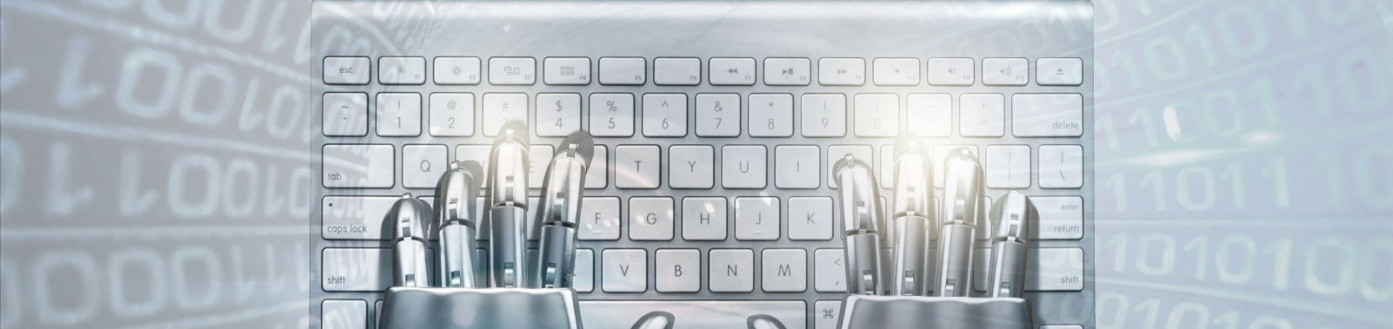
02
Applications of GPT
GPT can be used as a personal assistant to help manage daily tasks. For example, it can draft emails or messages based on your instructions, summarize long articles or reports for quick understanding, provide reminders for important dates or tasks, and even help with online shopping by comparing products based on reviews and descriptions. This can save time and effort, making daily life more efficient and convenient.

Slide 9
03.
Impact of GPT on Life

Slide 10
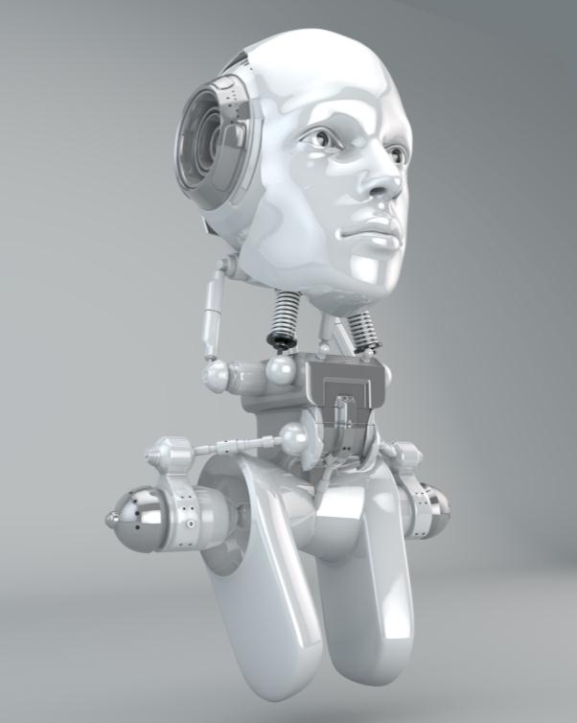
Natural Sciences
03
Impact of GPT on Life
GPT can assist in natural sciences by providing information, answering questions, and even generating hypotheses.
Intelligent Economy
In an intelligent economy, GPT can automate tasks that require language understanding and generation.
Intelligent Society
In an intelligent society, GPT can be used in various applications to improve efficiency and productivity.
Notes:
Natural Sciences: GPT can assist in natural sciences by providing information, answering questions, and even generating hypotheses. It can help scientists sift through large amounts of data, identify patterns, and generate insights. However, it's important to verify its outputs, as it doesn't truly understand the scientific method or principles.
Intelligent Economy: In an intelligent economy, GPT can automate tasks that require language understanding and generation. This includes drafting emails, writing reports, customer service, and more. It can also provide insights from large amounts of text data, aiding in decision-making processes.
Intelligent Society: In an intelligent society, GPT can be used in various applications to improve efficiency and productivity. This includes education (e.g., tutoring, content creation), communication (e.g., translation, summarization), and entertainment (e.g., game development, storytelling). However, it also raises ethical and societal issues, such as job displacement and misinformation, that need to be addressed.

Slide 11
04.
GPT’s value

Slide 12
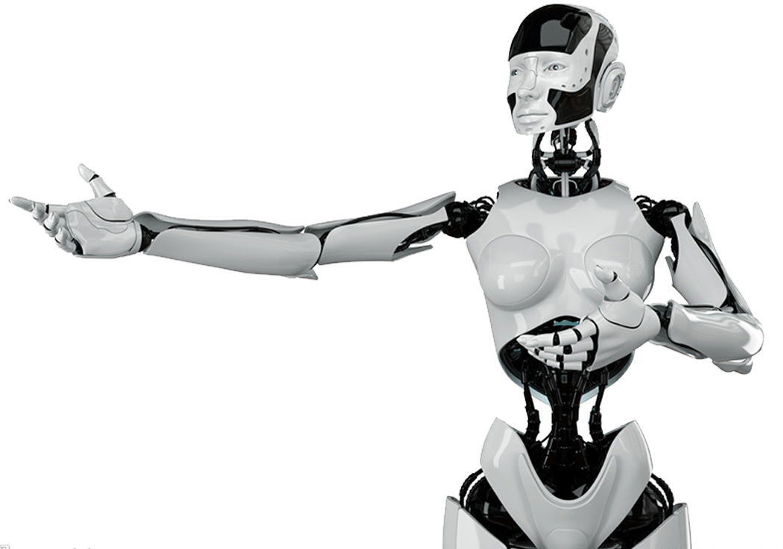
GPT’s value
04
GPT's value is rooted in its ability to understand and generate human-like text, enabling it to automate tasks, improve accessibility, provide personalized experiences, and drive innovation across various applications.
GPT、s value

Slide 13
05.
Weaknesses of GPT

Slide 14
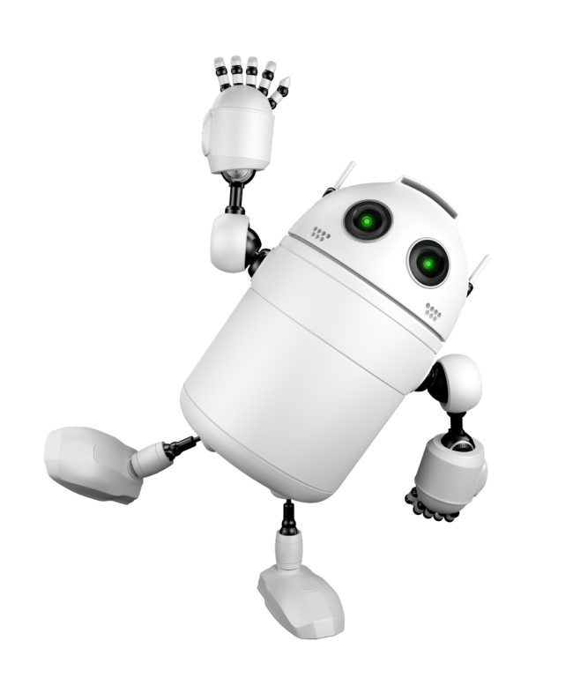
Weaknesses of GPT
05
Weaknesses: Although the advantages of GPT have been explained above, GPT has its weaknesses. It doesn't truly understand language or context. For example, it might generate inaccurate information if the input is ambiguous or misleading. It also has the potential for misuse, such as generating spam or misinformation. Furthermore, training and deploying GPT models can be resource-intensive, requiring significant computational power and data. For instance, OpenAI's GPT-3 model required a substantial amount of computational resources for training.
Weaknesses of GPT

Slide 15
06.
The future of GPT

Slide 16

Improved Performance:
Future versions of GPT are likely to show improved performance in understanding and generating human-like text. This could be achieved through advancements in model architecture, training techniques, and computational power.
New Applications:
As GPT's capabilities improve, it could be applied in new domains. For instance, it could be used in more complex tasks, such as scientific research or high-level decision-making.
Responsible AI Use:
The future of GPT also involves responsible AI use. This includes ensuring fairness, transparency, and privacy, and addressing ethical considerations.
06
The future of GPT

Slide 17
THANKS!
THE POWER OF GPT
Team Member Responsibilities：
温家振：PPT making
周同阳：Speech writing
章鹏程：Presenter
王昱硕：Video clip

